Slide 1
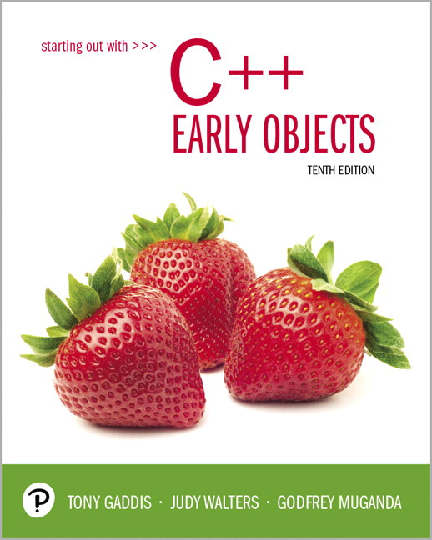
Starting Out with C++ Early Objects
Tenth Edition
Chapter 14
Recursion

Slide 2
Topics
14.1 Introduction to Recursion
14.2 The Recursive Factorial Function
14.3 The Recursive gcd Function
14.4 Solving Recursively Defined Problems
14.5 A Recursive Binary Search Function
14.6 The QuickSort Algorithm
14.7 The Towers of Hanoi
14.8 Exhaustive and Enumeration Algorithms
14.9 Recursion Versus Iteration

Slide 3
14.1 Introduction to Recursion
A recursive function is a function that calls itself.
Recursive functions can be useful in solving problems that can be broken down into smaller or simpler subproblems of the same type. A base case should eventually be reached, at which time the breaking down (recursion) will stop.

Slide 4
Recursive Functions 1 of 2
Consider a function for solving the count-down problem from some number num down to 0:
The base case is when num is already 0: the problem is solved and we “blast off!”
If num is greater than 0, we count off num and then recursively count down from num-1

Slide 5
Recursive Functions 2 of 2
A recursive function for counting down to 0:
void countDown(int num)
{
if (num == 0)
cout << "Blast off!";
else
{
cout << num << ". . .";
countDown(num-1); // recursive
} // call
}

Slide 6
What Happens When Called? 1 of 2
If a program contains a line like countDown(2);
countDown(2) generates the output 2..., then it calls countDown(1)
countDown(1) generates the output 1..., then it calls countDown(0)
countDown(0) generates the output Blast off!, then returns to countDown(1)
countDown(1) returns to countDown(2)
countDown(2)returns to the calling function
Notes:
See pr14-01.cpp, pr14-02.cpp

Slide 7
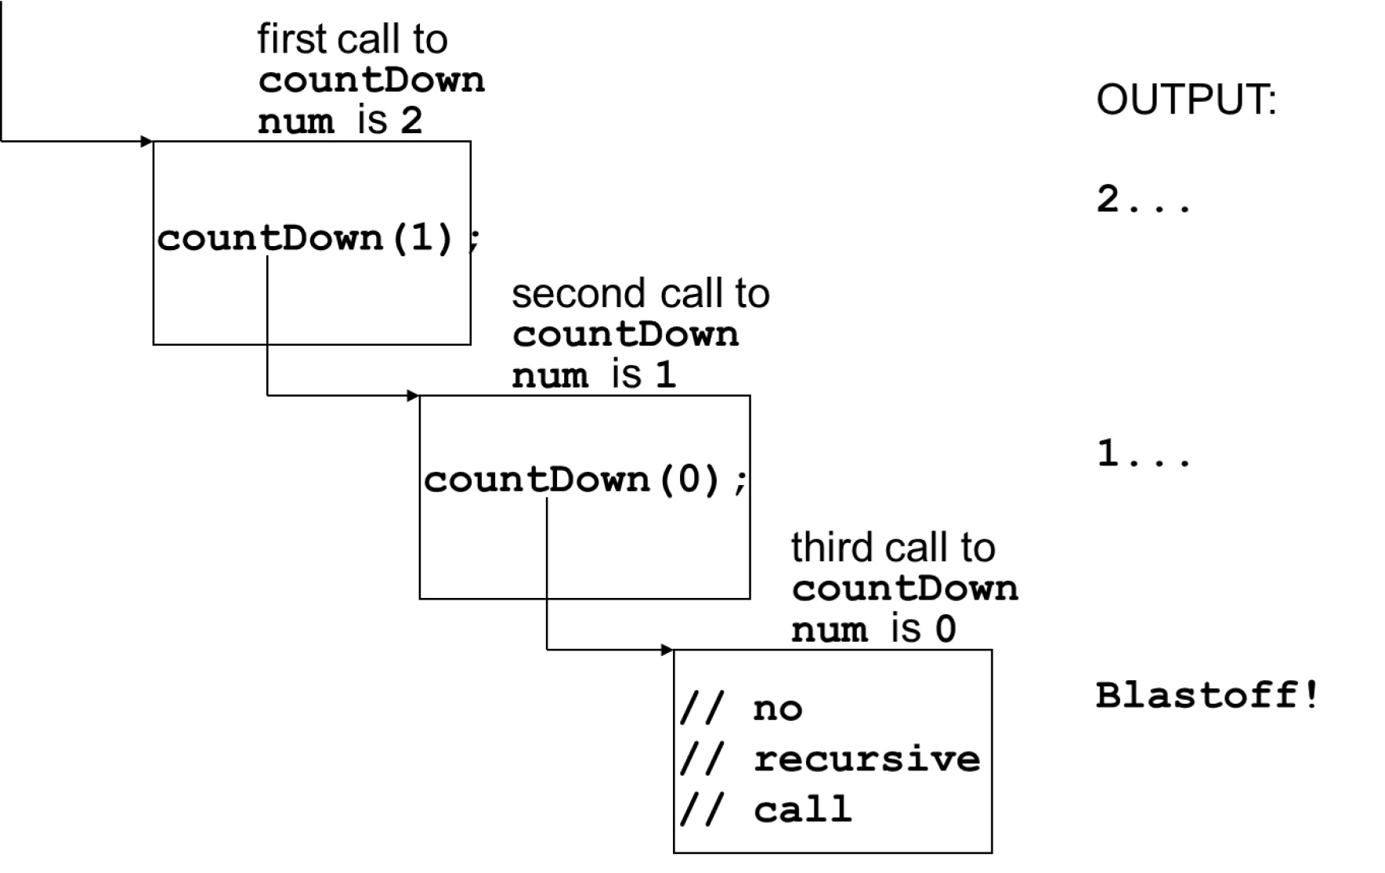
What Happens When Called? 2 of 2

Slide 8
Stopping the Recursion 1 of 4
A recursive function should include a test for the base cases
In the sample program, the test is:
if (num == 0)

Slide 9
Stopping the Recursion 2 of 4
void countDown(int num)
{
if (num == 0) // test
cout << "Blast off!";
else
{
cout << num << "...\n";
countDown(num-1); // recursive
} // call
}

Slide 10
Stopping the Recursion 3 of 4
With each recursive call, the parameter controlling the recursion should move closer to the base case
Eventually, the parameter reaches the base case and the chain of recursive calls terminates

Slide 11
Stopping the Recursion 4 of 4
void countDown(int num)
{
if (num == 0) // base case
cout << "Blast off!";
else
{ cout << num << "...\n";
countDown(num-1); // decrement
// parameter to approach base case
}
}

Slide 12
What Happens When Called?
Each time a recursive function is called, a new copy of the function runs, with new instances of parameters and local variables being created
As each copy finishes executing, it returns to the copy of the function that called it
When the initial copy finishes executing, it returns to the part of the program that made the initial call to the function
Notes:
See pr14-03.cpp

Slide 13
Types of Recursion
Direct recursion
a function calls itself
Indirect recursion
function A calls function B, and function B calls function A. Or,
function A calls function B, which calls …, which then calls function A

Slide 14
14.2 The Recursive Factorial Function 1 of 2
The factorial of a nonnegative integer n is the product of all positive integers less than or equal to n
The factorial of n is denoted by n!
The factorial of 0 is 1
0 ! = 1
n ! = n x (n-1) x … x 2 x 1 if n > 0

Slide 15
Recursive Factorial Function 2 of 2
The factorial of n can be expressed in terms of the factorial of n-1
0 ! = 1
n ! = n x (n-1) !
Recursive function:
int factorial(int n)
{ if (n == 0)
return 1; // base
else
return n *factorial(n-1);
}
Notes:
See pr14-04.cpp

Slide 16
14.3 The Recursive gcd Function 1 of 2
Greatest common divisor (gcd) of two integers x and y is the largest number that divides both x and y with no remainder.
The Greek mathematician Euclid discovered that
If y divides x, then gcd(x, y) is just y
Otherwise, the gcd(x, y) is the gcd of y and the remainder of dividing x by y

Slide 17
The Recursive gcd Function 2 of 2
int gcd(int x, int y)
{
if (x % y == 0) //base case
return y;
else
return gcd(y, x % y);
}
Notes:
See pr14-05.cpp

Slide 18
14.4 Solving Recursively Defined Problems
The natural definition of some problems leads to a recursive solution
Example: Fibonacci numbers:
0, 1, 1, 2, 3, 5, 8, 13, 21, ...
After the initial 0 and 1, each term is the sum of the two preceding terms
Recursive calculation of the nth Fibonacci number:
fib(n) = fib(n – 1) + fib(n – 2);
Base cases: n == 0, n == 1

Slide 19
Recursive Fibonacci Function
int fib(int n)
{
if (n <= 0) // base case
return 0;
else if (n == 1) // base case
return 1;
else
return fib(n – 1) + fib(n – 2);
}
Notes:
See pr14-06.cpp

Slide 20
14.5 A Recursive Binary Search Function
Assume an array a that is sorted in ascending order, and an item X to search for
We want to write a function that searches for X within the array a, returning the index of X if it is found, and returning -1 if X is not in the array

Slide 21
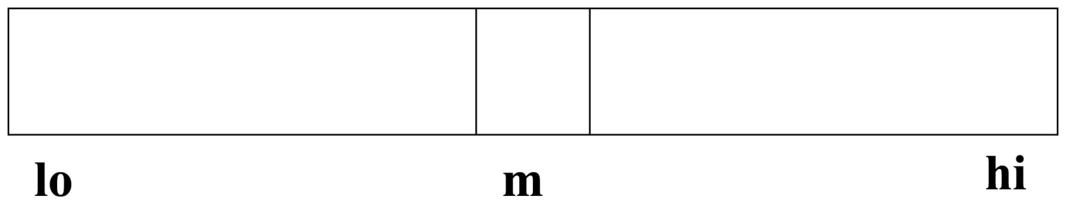
Recursive Binary Search 1 of 3
A recursive strategy for searching a portion of the array from index lo to index hi is to
set m to the index of the middle element of the array:

Slide 22
Recursive Binary Search 2 of 3
If a[m] == X, we found X, so return m
If a[m] > X, recursively search a[lo..m-1]
If a[m] < X, recursively search a[m+1..hi]

Slide 23
Recursive Binary Search 3 of 3
int bSearch(const int a[],int lo,
int hi,int X)
{
int m = (lo + hi) /2;
if(lo > hi) return -1; // base
if(a[m] == X) return m; // base
if(a[m] > X)
return bsearch(a,lo,m-1,X);
else
return bsearch(a,m+1,hi,X);
}
Notes:
See pr14-07.cpp

Slide 24
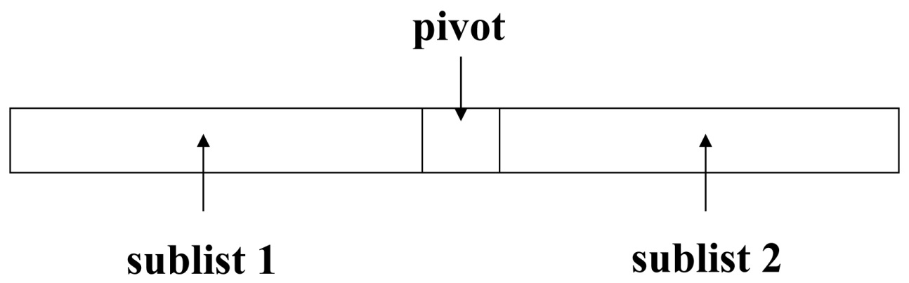
14.6 The QuickSort Algorithm 1 of 2
Recursive algorithm that can sort an array
First, determine an element to use as pivot value:

Slide 25
The QuickSort Algorithm 2 of 2
Then, values are shifted so that elements in sublist1 are < pivot and elements in sublist2 are >= pivot
Algorithm then recursively sorts sublist1 and sublist2
Base case: a sublist has size <=1
Ex: pr 14-8
Notes:
See pr14-08.cpp

Slide 26
int partition(int arr[], int start, int end)
{
int pivotValue = arr[start];
int pivotPosition = start;
for (int pos = start + 1; pos <= end; pos++)
{
if (arr[pos] < pivotValue)
{
swap(arr[pivotPosition + 1], arr[pos]);
swap(arr[pivotPosition], arr[pivotPosition + 1]);
pivotPosition ++;
}
}
return pivotPosition;
}
void quickSort(int arr[], int start, int end)
{
if (start < end)
{
int p = partition(arr, start, end);
quickSort(arr, start, p - 1);
quickSort(arr, p + 1, end);
}
}

Slide 27
QS(arr, 0,9);
0 < 9
{
4 = partition(arr, 0, 9);
quickSort(arr, 0, 3);
quickSort(arr, 5, 9);
}
17 | 53 | 9 | 2 | 30 | 1 | 82 | 64 | 26 | 5
17 | 53 | 9 | 2 | 30 | 1 | 82 | 64 | 26 | 5
Pivot
17 | 9 | 53 | 2 | 30 | 1 | 82 | 64 | 26 | 5
Pivot
9 | 17 | 53 | 2 | 30 | 1 | 82 | 64 | 26 | 5
Pivot
9 | 17 | 2 | 53 | 30 | 1 | 82 | 64 | 26 | 5
Pivot
9 | 2 | 17 | 53 | 30 | 1 | 82 | 64 | 26 | 5
Pivot
9 | 2 | 17 | 1 | 30 | 53 | 82 | 64 | 26 | 5
Pivot

Slide 28
QS(arr, 0,9);
Pivot =4;
9 | 2 | 1 | 17 | 30 | 53 | 82 | 64 | 26 | 5
Pivot
9 | 2 | 1 | 17 | 5 | 53 | 82 | 64 | 26 | 30
Pivot
9 | 2 | 1 | 5 | 17 | 53 | 82 | 64 | 26 | 30
Pivot

Slide 29
9 | 2 | 1 | 5 | 17 | 53 | 82 | 64 | 26 | 30
quickSort(arr, 0, 3);
{
0<3
3 = partition(arr, 0, 3);
quickSort(arr, 0, 2);
quickSort(arr, 4, 3); done
}
Pivot
2 | 9 | 1 | 5 | 17 | 53 | 82 | 64 | 26 | 30
Pivot
2 | 1 | 9 | 5 | 17 | 53 | 82 | 64 | 26 | 30
Pivot
2 | 1 | 5 | 9 | 17 | 53 | 82 | 64 | 26 | 30
Pivot
2 | 1 | 5 | 9 | 17 | 53 | 82 | 64 | 26 | 30
quickSort(arr, 0, 2);
{
0<2
1 = partition(arr, 0, 2);
quickSort(arr, 0, 0);done
quickSort(arr, 2, 2); done
}
Pivot
1 | 2 | 5 | 9 | 17 | 53 | 82 | 64 | 26 | 30
Pivot
1 | 2 | 5 | 9 | 17 | 53 | 82 | 64 | 26 | 30
Pivot

Slide 30
QS(arr, 5,9);
5 < 9
{
7 = partition(arr, 5, 9);
quickSort(arr, 5, 6);
quickSort(arr, 8, 9);
}
1 | 2 | 5 | 9 | 17 | 53 | 82 | 64 | 26 | 30
Pivot
1 | 2 | 5 | 9 | 17 | 53 | 26 | 64 | 82 | 30
Pivot
1 | 2 | 5 | 9 | 17 | 26 | 53 | 64 | 82 | 30
QS(arr, 5, 6);
5 < 6
{
5 = partition(arr, 5, 6);
quickSort(arr, 5, 4); done
quickSort(arr, 6, 6); done
}
Pivot
1 | 2 | 5 | 9 | 17 | 26 | 53 | 30 | 82 | 64
Pivot
1 | 2 | 5 | 9 | 17 | 26 | 30 | 53 | 82 | 64
Pivot
1 | 2 | 5 | 9 | 17 | 26 | 30 | 53 | 82 | 64
QS(arr, 8, 9);
8 < 9
{
9 = partition(arr, 8, 9);
quickSort(arr, 8, 8); done
quickSort(arr, 10, 9); done
}
Pivot
1 | 2 | 5 | 9 | 17 | 26 | 30 | 53 | 64 | 82
Pivot
1 | 2 | 5 | 9 | 17 | 26 | 30 | 53 | 64 | 82

Slide 31
Merge Sort Algorithm
Divide: Divide the n-element sequence to be sorted into two subsequences of n/2 elements each.
Conquer: Sort the two subsequences recursively using merge sort.
Combine: Merge the two sorted subsequences to produce the sorted answer.
The recursion “bottoms out” when the sequence to be sorted has length 1, in which case there is no work to be done.

Slide 33
Because we are dealing with subproblems, we state each subproblem as sorting a subarray A[p . .r].
Initially, p =1 and r = n, but these values change as we recurs through subproblems.

Slide 34
To sort A[p . .r]:
Divide by splitting into two subarrays A[p . .q]. and A[q+1 . .r],
where q is the halfway point of A[p . .r].
Conquer by recursively sorting the two subarrays
A[p . .q]. and A[q+1 . .r].
Combine by merging the two sorted subarrays A[p . .q]. and A[q+1 . .r] to produce a single sorted subarray A[p . .r].
To accomplish this step, we’ll define a procedure: MERGE(A, p, q, r).

Slide 35
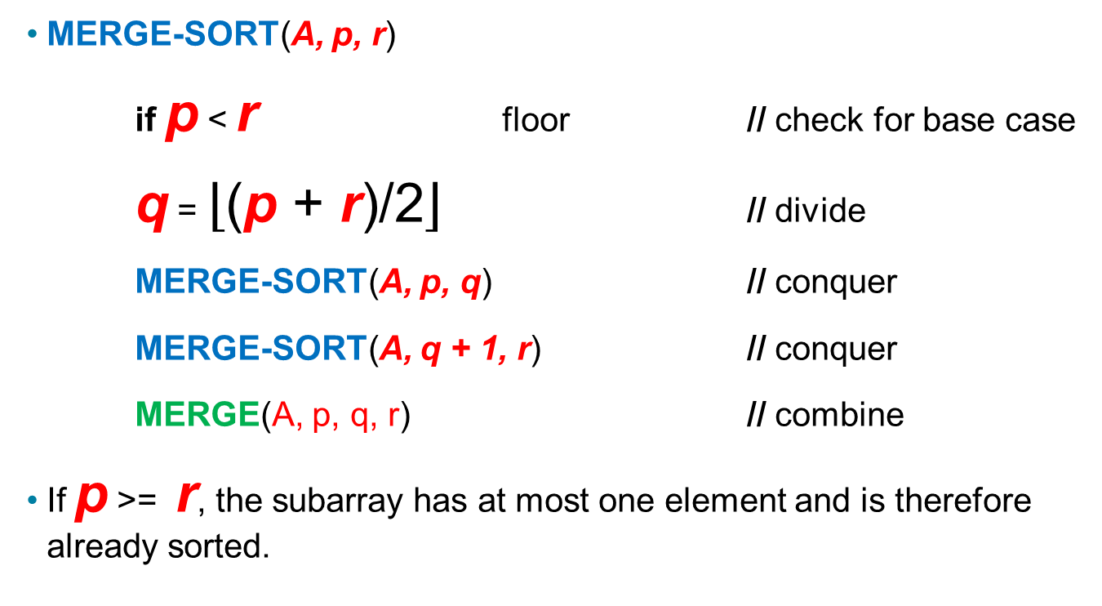
MERGE-SORT(A, p, r)
if p < r floor // check for base case
q = $\left\lfloor \text{(}\text{p}\text{ + }\text{r}\text{)/2}\right\rfloor$ // divide
MERGE-SORT(A, p, q) // conquer
MERGE-SORT(A, q + 1, r) // conquer
MERGE(A, p, q, r) // combine
If p >= r, the subarray has at most one element and is therefore already sorted.

Slide 37
[Here, at the next-to-last level of recursion, some of the subproblems have only 1
element. The recursion bottoms out on these single-element subproblems.]

Slide 38
Merging
The MERGE procedure:
Input: Array A and indices p, q, and r such that
p <= q < r.
Subarray A[p . .q] is sorted and subarray A[q+1 . .r] is sorted. By the restrictions on p, q, r, neither subarray is empty.
Output: The two subarrays are merged into a single sorted subarray in A[p . .r] .

Slide 42
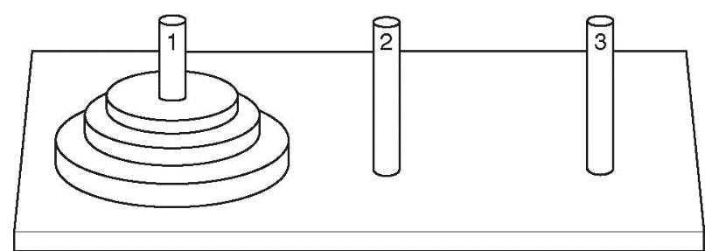
14.7 The Towers of Hanoi 1 of 2
Setup: 3 pegs, one has n disks on it, the other two pegs empty. The disks are arranged in increasing diameter, top→ bottom
Objective: move the disks from peg 1 to peg 3, observing these rules:
only one disk moves at a time
all remain on pegs except the one being moved
a larger disk cannot be placed on top of a smaller disk at any time

Slide 43
The Towers of Hanoi 2 of 2
How it works:
Number of Disks | Sequence of Moves
n=1 | Move disk from peg 1 to peg 3. Done.
n=2 | Move top disk from peg 1 to peg 2. Move remaining disk from peg 1 to peg 3. Move disk from peg 2 to peg 3. Done.

Slide 44
Outline of the Recursive Algorithm
If n==0, do nothing (base case)
If n>0, then
Move the topmost n-1 disks from peg1 to peg2
Move the n^{th} disk from peg1 to peg3
Move the n-1 disks from peg2 to peg3
end if
Notes:
See pr14-09.cpp

Slide 45
14.8 Exhaustive and Enumeration Algorithms
Enumeration algorithm: generate all possible combinations
Example: all possible ways to make change for a certain amount of money
Exhaustive algorithm: search a set of combinations to find an optimal one
Example: change for a certain amount of money that uses the fewest coins
Notes:
See pr14-10.cpp

Slide 46
14.9 Recursion vs. Iteration
Benefits (+), disadvantages(-) for recursion:
Natural formulation of solution to certain problems
May not execute very efficiently
Benefits (+), disadvantages(-) for iteration:
Executes more efficiently than recursion
May not be as natural a method of solution as recursion for some problems

Slide 47

Copyright

